Slide 1
Microprocessor Fundamentals
Juan-Bernardo Gómez-Mendoza
Universidad Nacional de Colombia - Manizales
Dept. of Electric, Electronic and Computing Engineering
2025-1S

Slide 2
Outline
What is a microprocessor.
Instruction set architecture.
Instruction execution pipeline.
Logical elements of a microprocessor.
Approaches:
Harvard vs Princeton
ISA: CISC vs RISC
Bit ordering: endianness.
Superscalar architectures.

Slide 3
What is a microprocessor
From a Hardware perspective:
Set of combinational (ALU, Instruction decoders, muxes, etc.) and sequential (registers, memories, etc.) digital hardware that implements an instruction set.
From a conceptual perspective:
Device that moves, stores and transform information, according with the operations described in an instruction set architecture (ISA).

Slide 4
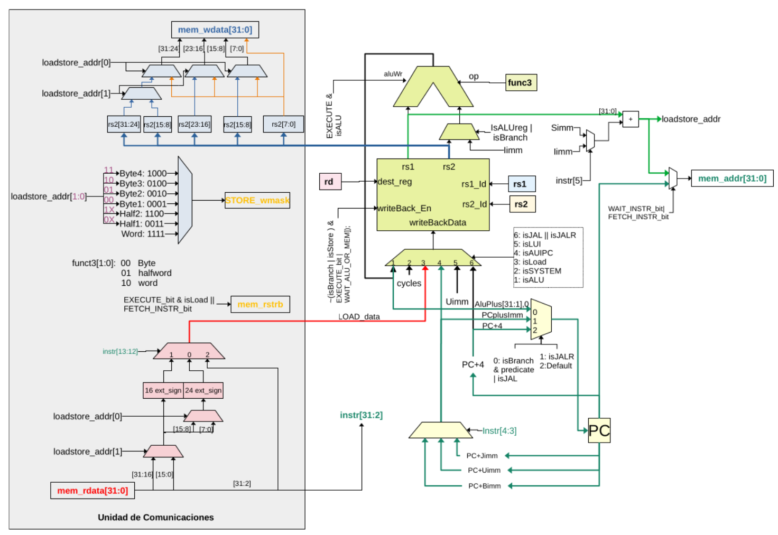

Slide 5
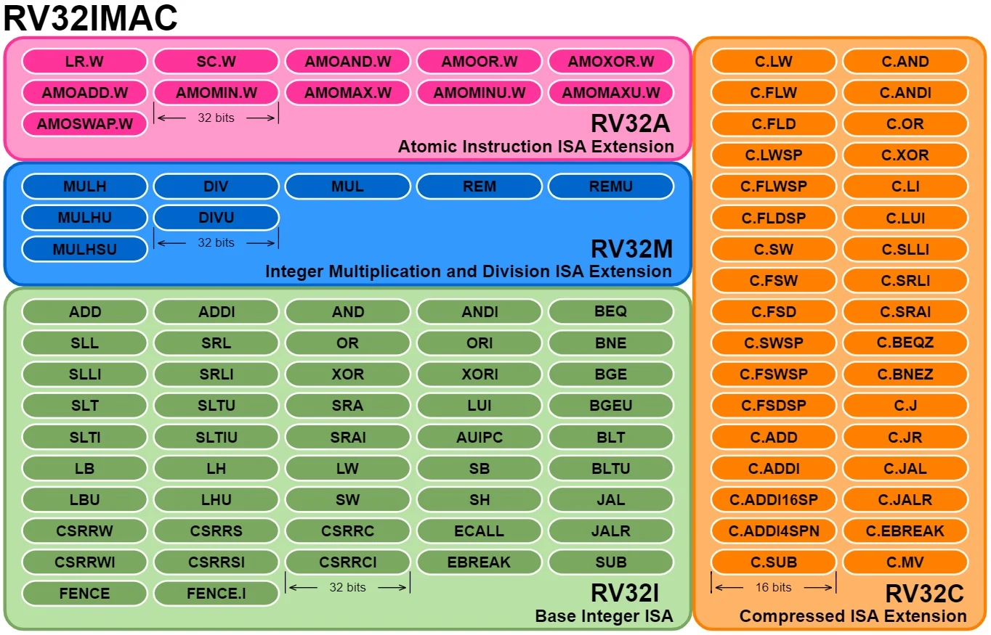
Instruction set architecture

Slide 6
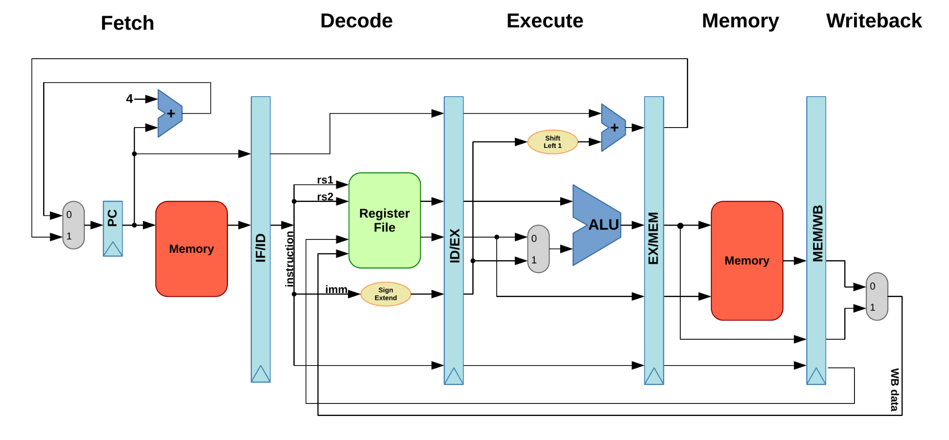
Instruction execution pipeline

Slide 7
Logical elements of a microprocessor

Slide 8
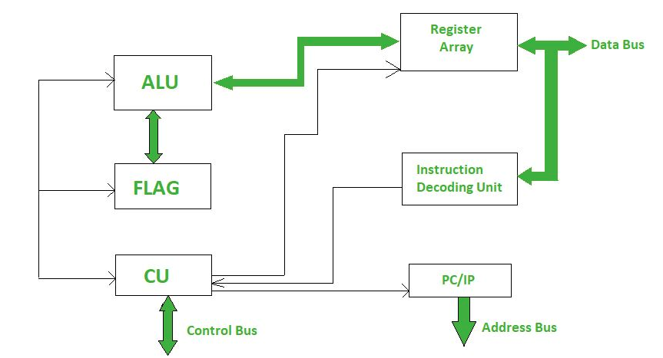

Slide 9
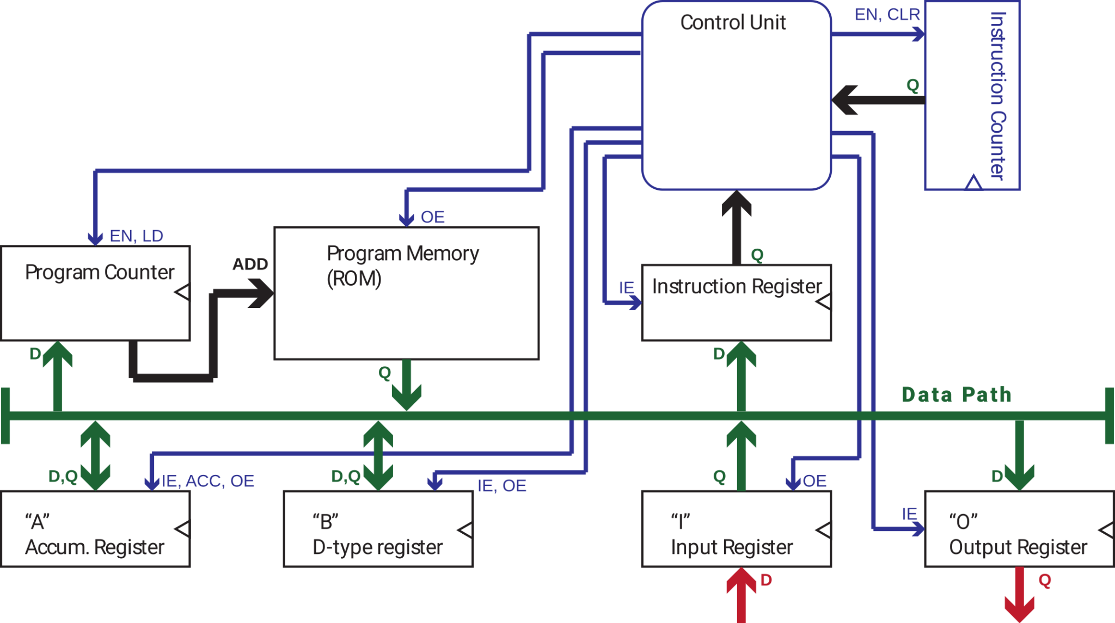

Slide 10
Logical elements of a microprocessor
Instruction register*.
Program counter.
Control unit/ instruction decoder.
G.P. Registers.
Program memory*.
Data memory*.
Data bus, address bus and control lines.
Routing logic (muxes, other).

Slide 11
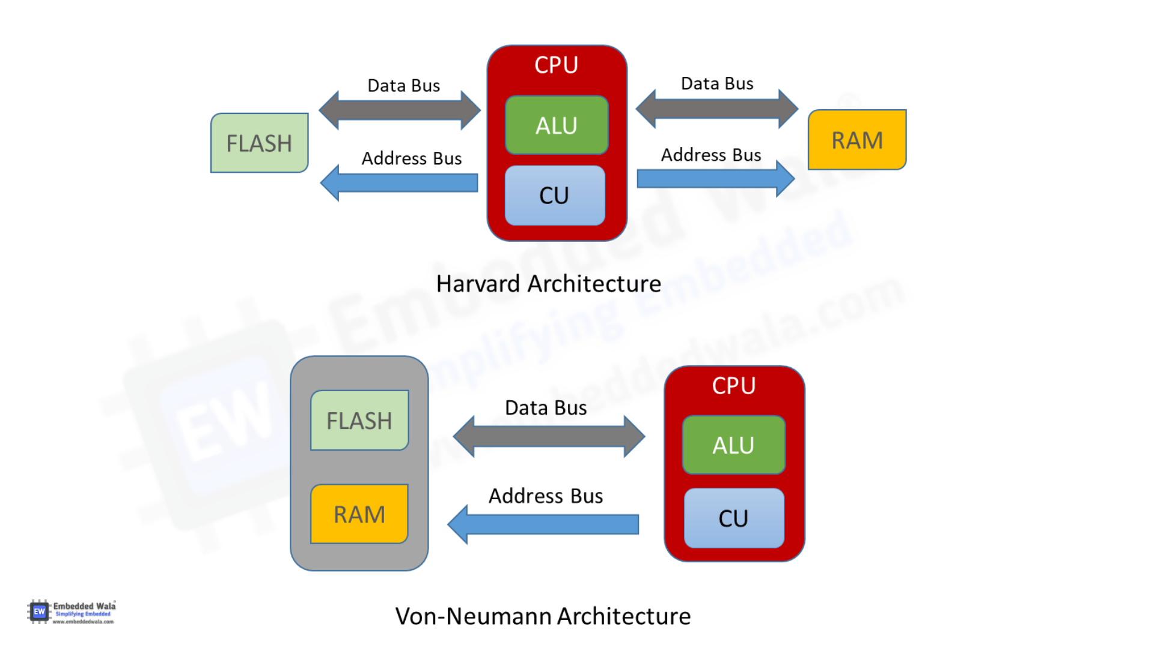
Harvard vs Von Neumann architectures

Slide 12
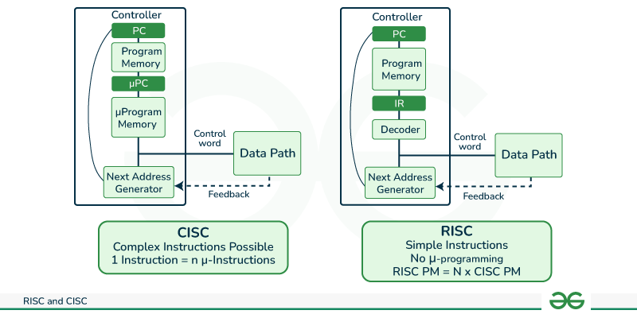
CISC vs RISC

Slide 13
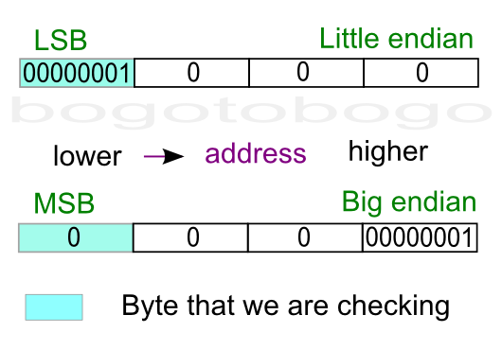
Endianness
Big endian:
IBM System/360, System/370, ESA/390, and z/Architecture.
PDP-10 uses big-endian addressing for byte-oriented instructions.
Motorola 6800 / 6801, the 6809 and the 68000.
Little-Endian:
Intel x86, AMD 64.
Atmel AVR.
ARM*, RISC V*.

Slide 14
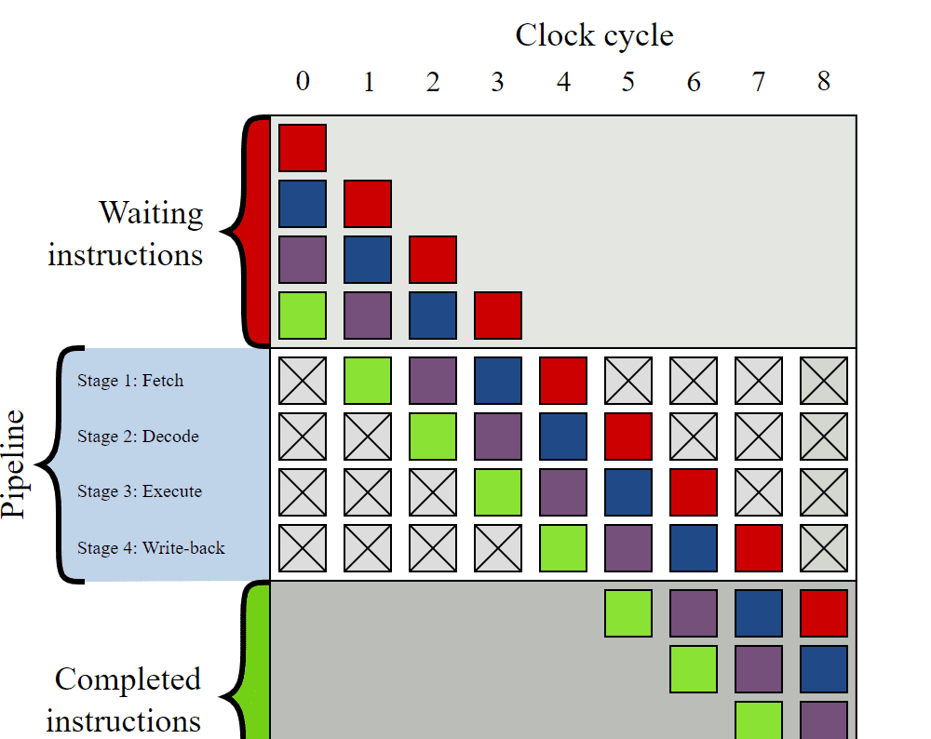
Superscalar architectures

